Slide 1

CRASH ANALYSIS OF A FOUR WHEEL VEHICLE PRESENTED BY RISE KRISHNA SAI PRAKASAM GROUP OF INSTITUTIONS
PROJECT MEMBERS
M.NAGARJUNA REDDY (158A1A0326)
U. BRAHMAIAH (158A1A0350)
K.REVANTH (158A1A0319) PROJECT GUIDE
E.ASHOK KUMAR (158A1A0313) D.ASHOK
A. PHANEENDRA (158A1A0303) (Asst. PROFESSOR)

Slide 2
CONTENTS
Introduction
Abstract
Present Work
Velocity Combinations With Materials
Car Designs In Catia
Results and comparative graphs
Conclusion
References

Slide 3
INTRODUCTION
With increase in fuel price and need for safer vehicle, it is important to analyse the crashworthiness of automobile structure. Crashworthiness can be defined as the capability of a structure to safeguard its passengers during an impact.

Slide 4
ABSTRACT With the improvements in roadways and implementation of new design technologies to automobiles, vehicle safety has found a tremendous turn in these days. Even automobile community is making its continuous effort to improve automobile safety to reduce injury and death drastically. In the present work one such effort is showcased by carrying out crash analysis of car at different velocities using ANSYS Explicit Dynamics approach. Structural Steel and other some more materials as wall(obstacle) are used and aluminum alloy, magnesium alloys are taken as the body material for car model.

Slide 5
PRESENT WORK
**With respect to velocity
1.At 35 m/s (126 km/hr)
2.At 45 m/s (162 km/hr)
3.At 55 m/s (198 km/hr)
4.At 65 m/s (234 km/hr)
**Materials assigned are Structural Steel,Aluminium Alloy, Magnesium Alloys.
Structural Steel.png properties
Al ALLOY.png
properties
Mg ALLOY.png properties

Slide 6
Velocity combinations with materials
***Frontal impact combinations
35+AL+SS+F
45+AL+SS+F
55+AL+SS+F
35+MG+SS+F
45+MG+SS+F
55+MG+SS+F
45+AL+AL+F
45+MG+MG+F
frontal impact, car vs. obstacle
frontal impact, car vs. car

Slide 7
Velocity combinations with materials
***Side impact combinations
55+AL+AL+S
55+MG+MG+S
60+AL+AL+S
60+MG+MG+S
side impact, car vs. car

Slide 8
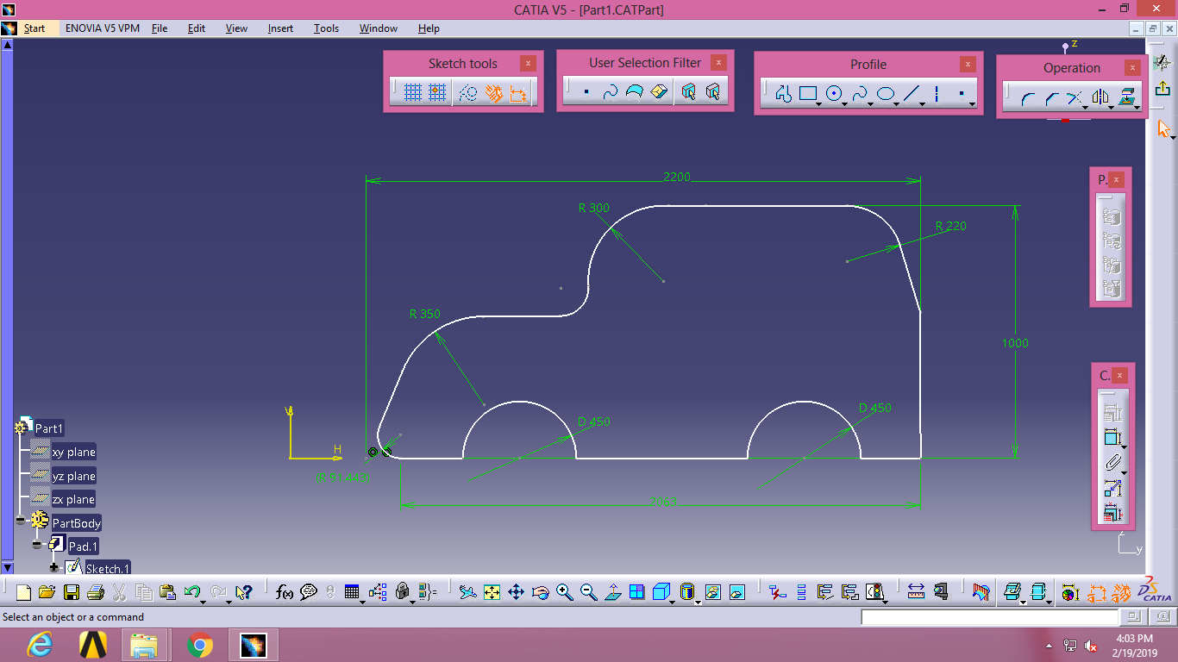
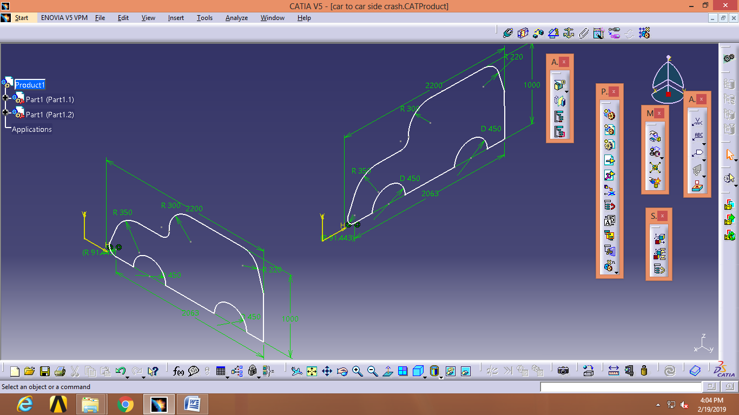
CAR SKETCHES IN CATIA SKETCH VIEW

Slide 9
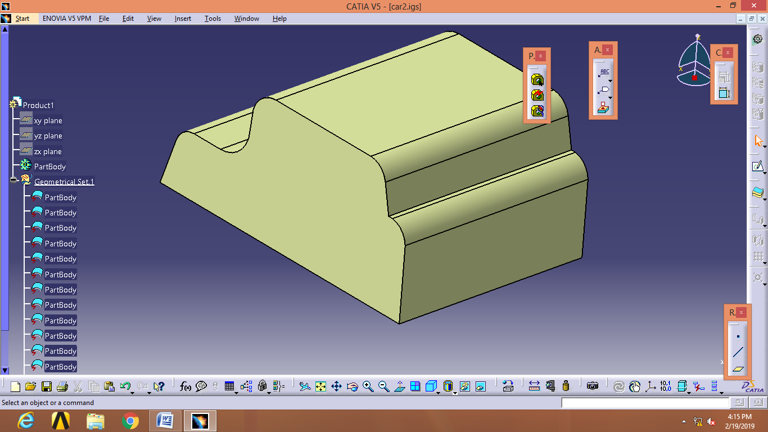
CAR IGS FORMAT SKETCHES

Slide 10
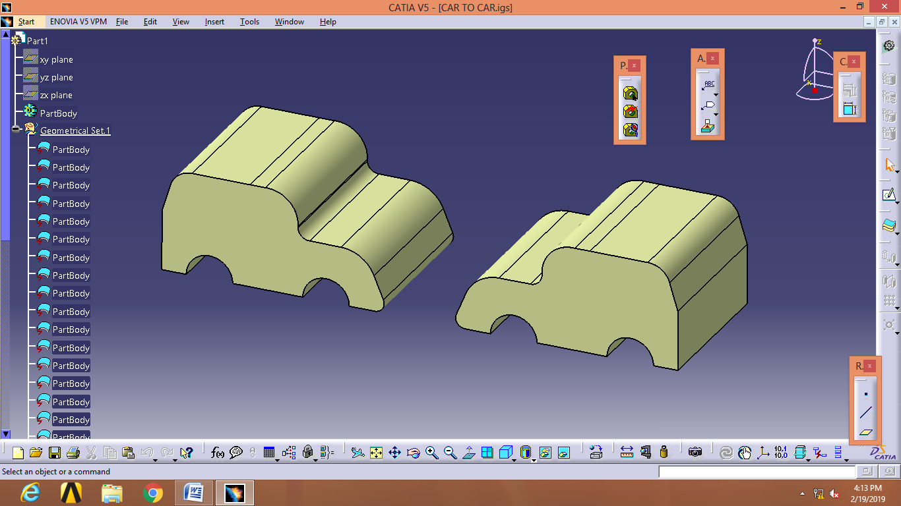
CAR VS. CAR,FRONTAL IMPACT
car blueprint.jpg

Slide 11
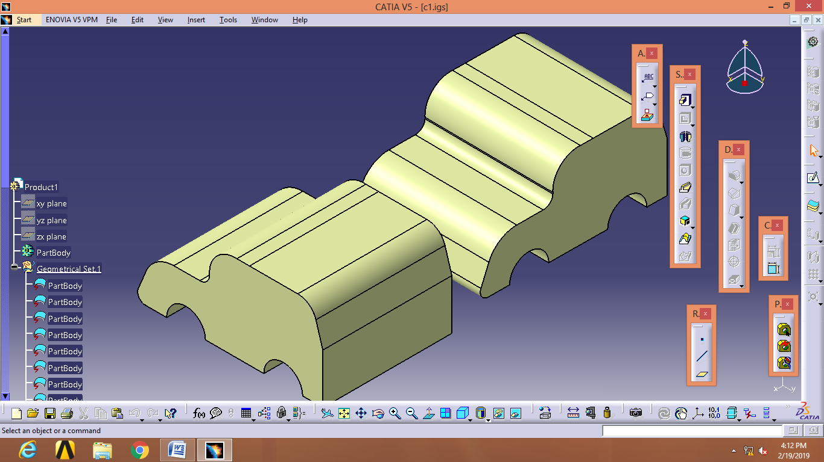
CAR VS. CAR,SIDE IMPACT

Slide 12
FRONTAL IMPACT, CAR VS. OBSTACLE CAR MATERIAL-ALUMINIUM ALLOY,OBSTACLE-STRUCTURAL STEEL
S.NO | VELOCITY (m/s) | TOTAL DEFORMATION (mm) | STRAIN | STRESS (N/mm²)
1 | 35 | 350.02 | 0.0016977 | 117.68
2 | 45 | 450.26 | 0.0033969 | 240.82
3 | 55 | 551.35 | 0.0036422 | 257.63

Slide 13
FRONTAL IMPACT, CAR VS. OBSTACLE CAR MATERIAL-MAGNESIUM ALLOY,OBSTACLE-STRUCTURAL STEEL
S.NO | VELOCITY (m/s) | TOTAL DEFORMATION (mm) | STRAIN | STRESS (N/mm²)
1 | 35 | 350.03 | 0.0018185 | 80.148
2 | 45 | 451.1 | 0.0098514 | 442.58
3 | 55 | 553.89 | 0.006406 | 288.13

Slide 14
FRONTAL IMPACT, CAR VS. CAR CAR MATERIALS-(7)ALUMINIUM ALLOY,(8)MAGNESIUM ALLOY
S.NO | VELOCITY | TOTAL DEFORMATION | STRAIN | STRESS
7 | 45m/s | 654.84mm | 0.18102 | 9491N/mm²
8 | 45m/s | 924.54mm | 0.12171 | 5348.9N/mm²

Slide 15
SIDE IMPACT, CAR VS. CAR CAR MATERIALS-ALUMINIUM ALLOY
S.NO | VELOCITY | TOTAL DEFORMATION | STRAIN | STRESS
9 | 55m/s | 550.21mm | 0.029581 | 1733.5N/mm²
10 | 60m/s | 600.29mm | 0.0090137 | 625.29N/mm²

Slide 16
SIDE IMPACT, CAR VS. CAR CAR MATERIALS-MAGNESIUM ALLOY
S.NO | VELOCITY | TOTAL DEFORMATION | STRAIN | STRESS
11 | 55m/s | 550.16mm | 0.030022 | 1121.9N/mm²
12 | 60m/s | 600.26mm | 0.0095194 | 422.79N/mm²

Slide 17
GRAPHS, car Vs. obstacle

Slide 18
car Vs. obstacle

Slide 19
Car Vs. obstacle

Slide 20
RESULTS FOLDERS
FRONTAL IMPACT IMAGES
SIDE IMPACT IMAGES
IGS FILES
CATIA SKETCHES
CRASH REPORT FINAL

Slide 21
CONCLUSION
It was seen that at low velocity majority of the impact force was absorbed by the front part of the car with slight deformation. But at high velocity, impact resulted in permanent deformation of the car model. The extent of plastic deformation of the car increased with increase in velocity with front part of the car absorbing the major part of the impact energy, Bumper, bonnet, A Pillar(obstacle) and wind shield were the major parts to undergo plastic deformation.
Finally, Aluminium Alloy car body material is much better than Magnesium Alloy car body material.

Slide 22
REFERENCES 1. G D Lohith Kumar, H S Manjunath, N Shashikanth, Venkatesh Reddy are done crash analysis of a four-wheel vehicle with different velocities. (2018 August). https://en.wikipedia.org/wiki/Aluminium_alloy https://en.wikipedia.org/wiki/Magnesium_alloy
RJ
M
v

Slide 23
ANY QUERIES & SUGGESTIONS

Slide 24
THANK YOU

